Slide 1
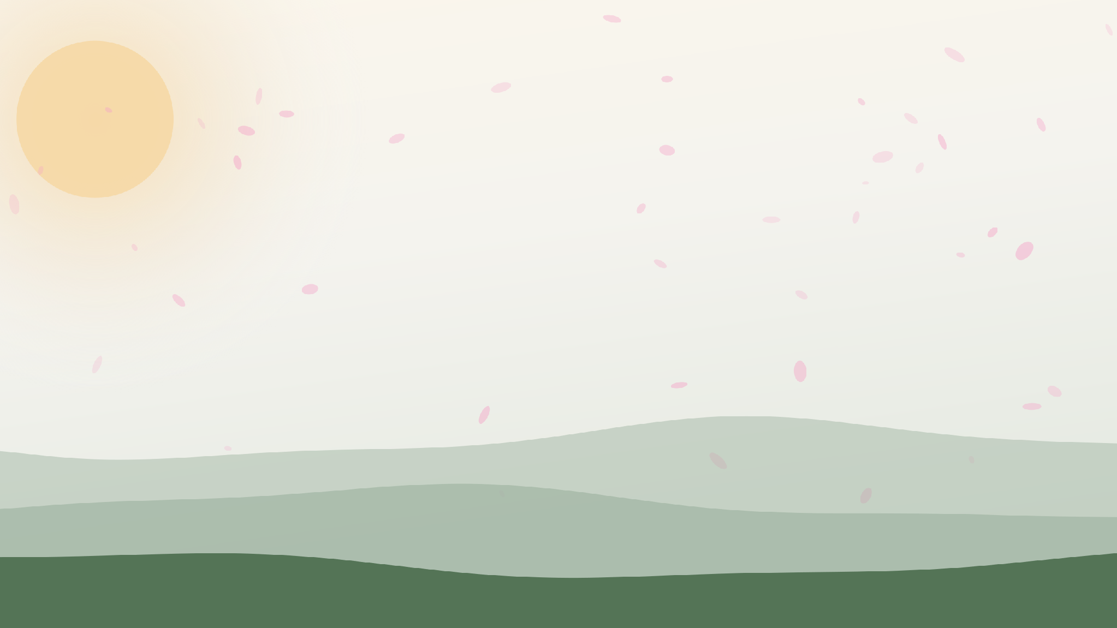
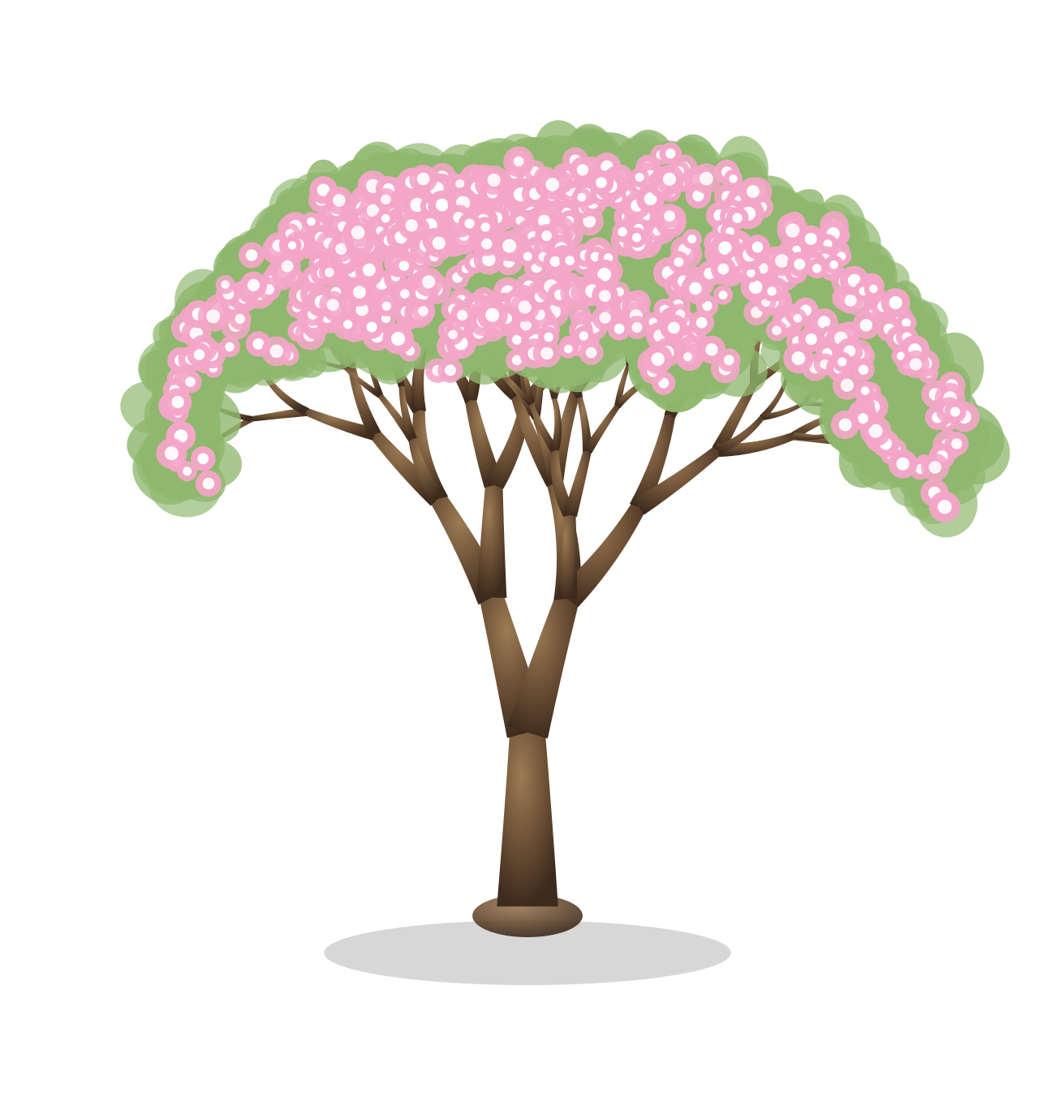
Grove
Grow together, one task at a time.

Slide 2
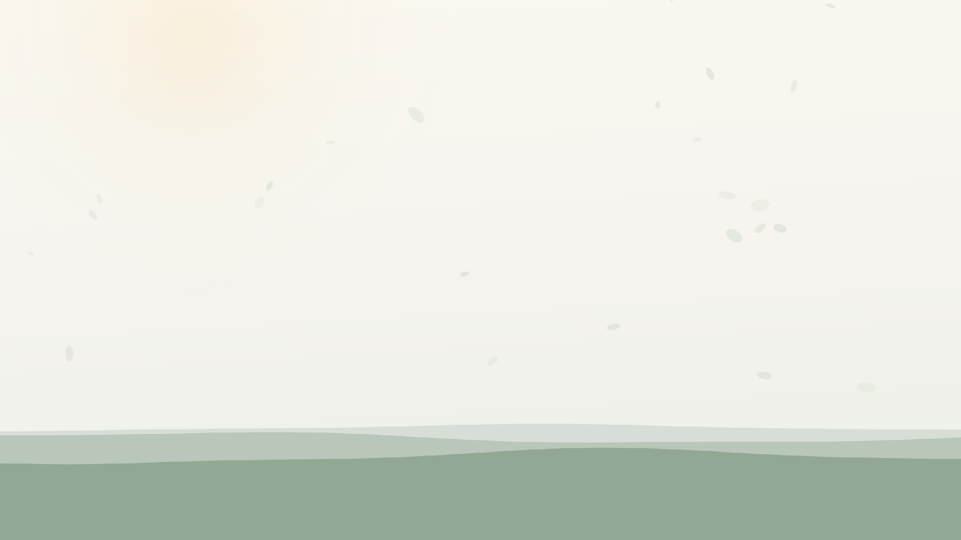
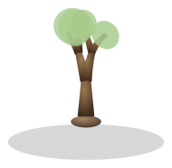
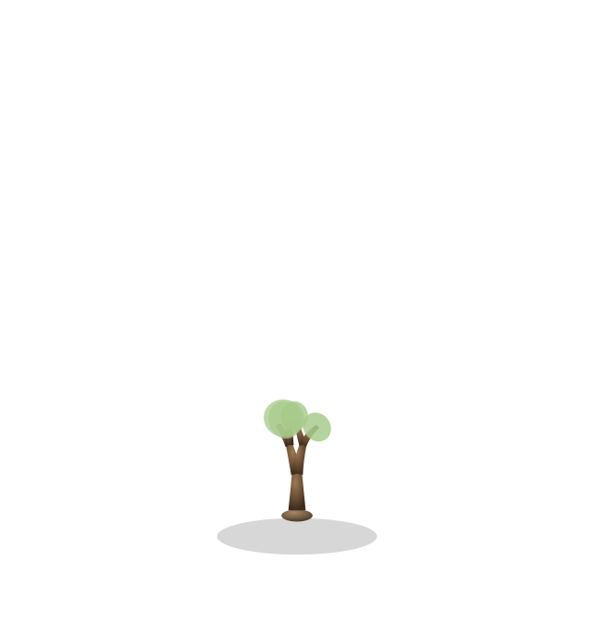
Problem & Target Users
THE PROBLEM
Starting something new is hard, whether it's a habit or an assignment. It's easy to keep putting it off, and doing it alone makes it worse, since there's no one around to keep you accountable.
WHO IT'S FOR
Anyone trying to build better habits or stay on top of their workload, who gets more done with someone else around.

Slide 3

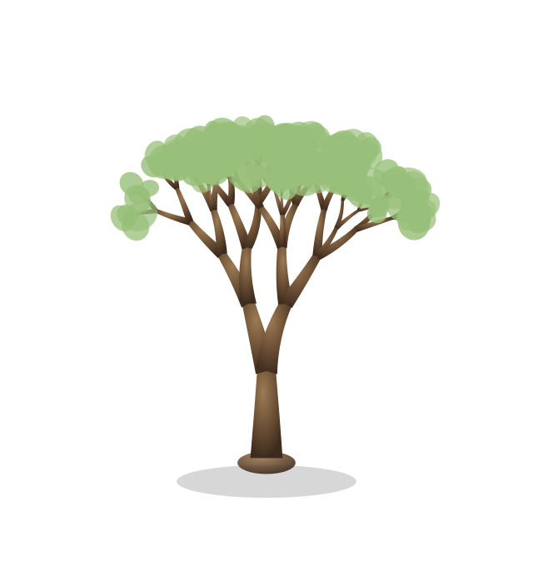
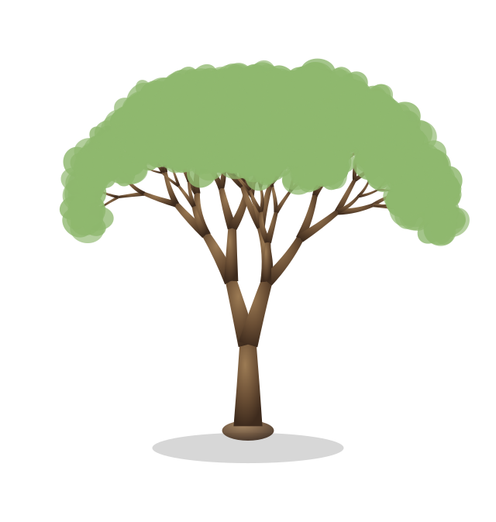
Needfinding
WHO WE TALKED TO
We sat down with people to understand how they manage day-to-day tasks. We wanted to know what gets in their way, and what it costs them emotionally when the work feels like something to avoid.
WHAT WE FOUND
Starting was hard for everyone we talked to, whether it was low motivation, distractions at home, or negative feelings tied to the task itself. For most, it got easier in a calmer, more comfortable space, or with other people nearby. Feeling truly finished was harder — some said they never really felt done, even after finishing their work.
“How might we help someone feel supported enough to start, and know when they’re truly done?”

Slide 4
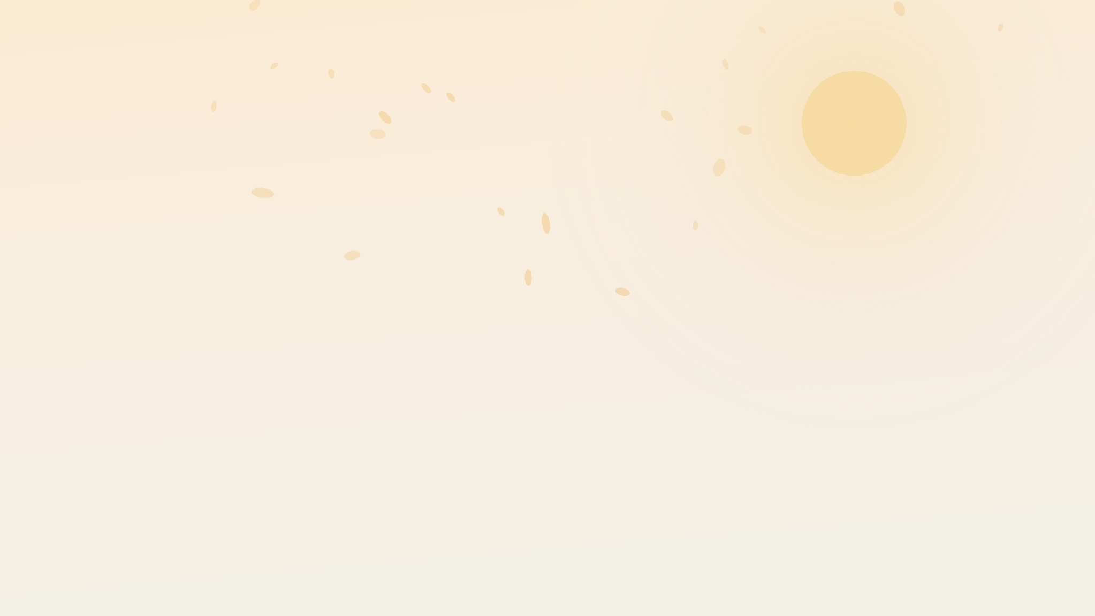
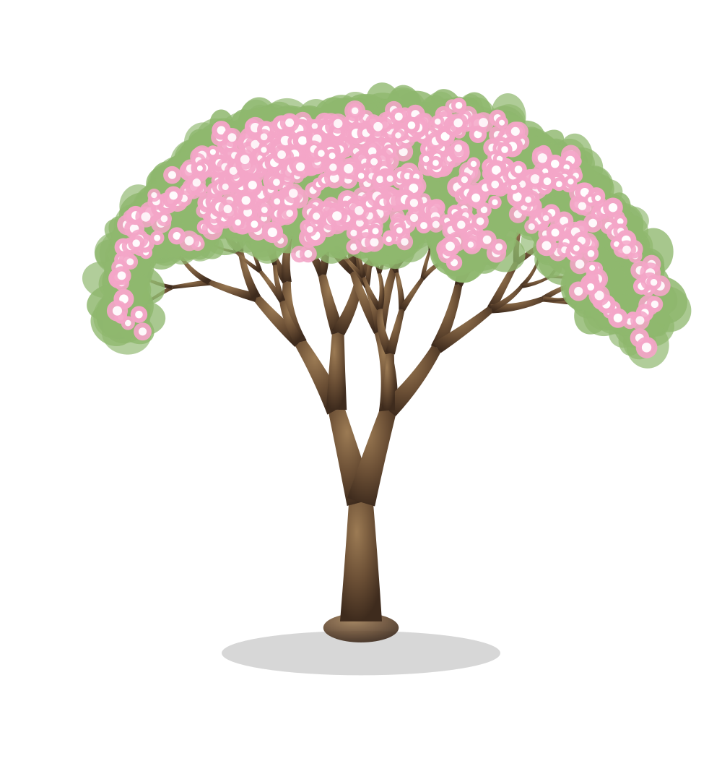
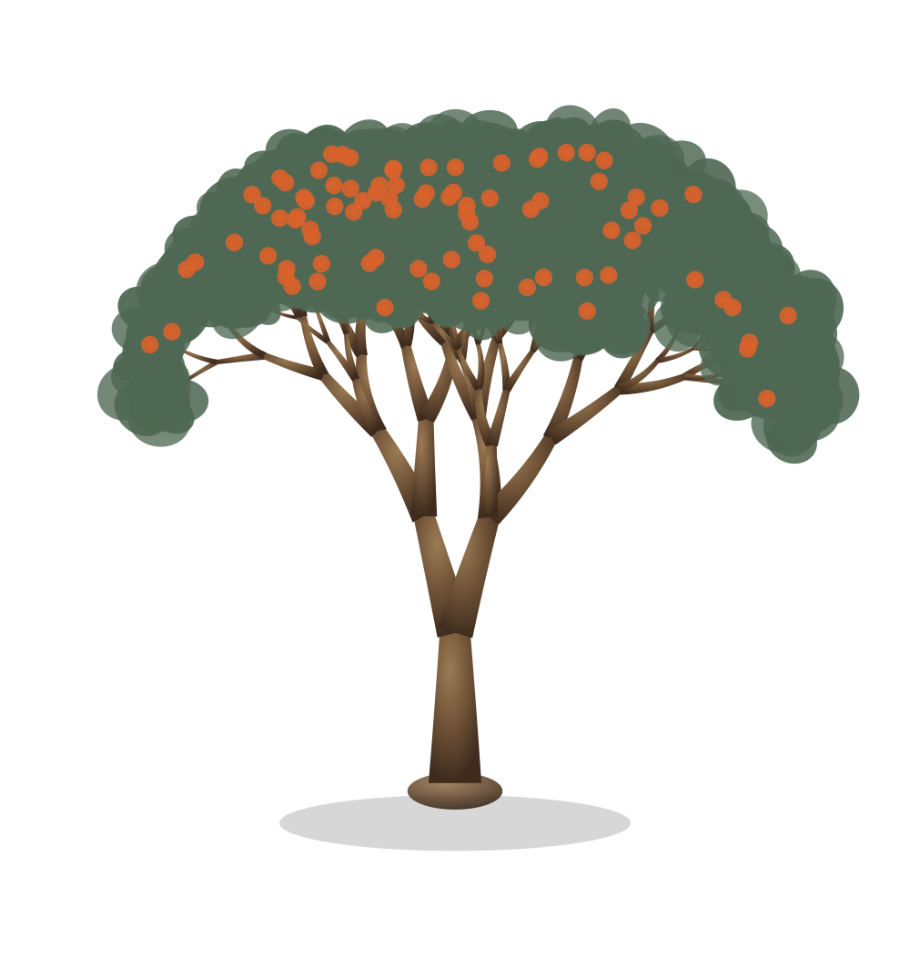
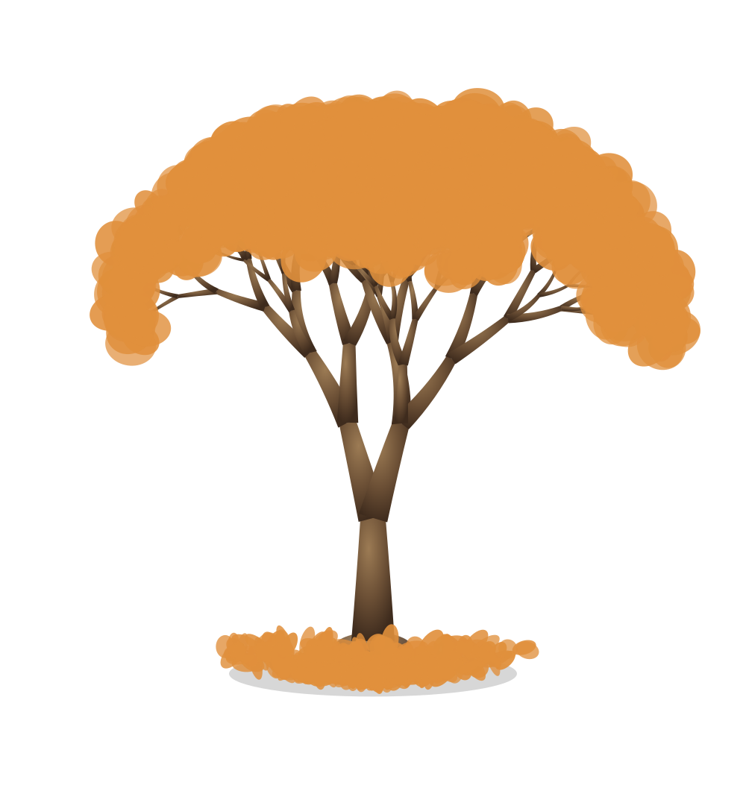
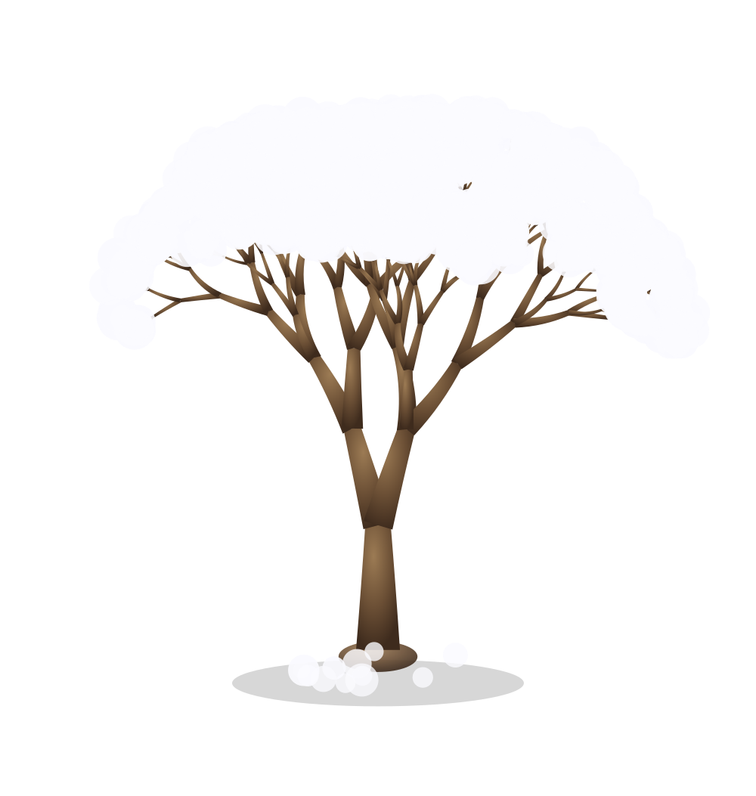
Lo-Fi Prototyping
a
a
a
a
a
a
a
a
a
a
a
a
a
a

Slide 5
Hi-Fi Prototyping
a
a
a
a
a

Slide 6
Implementation
a
a
a
a
a

Slide 7
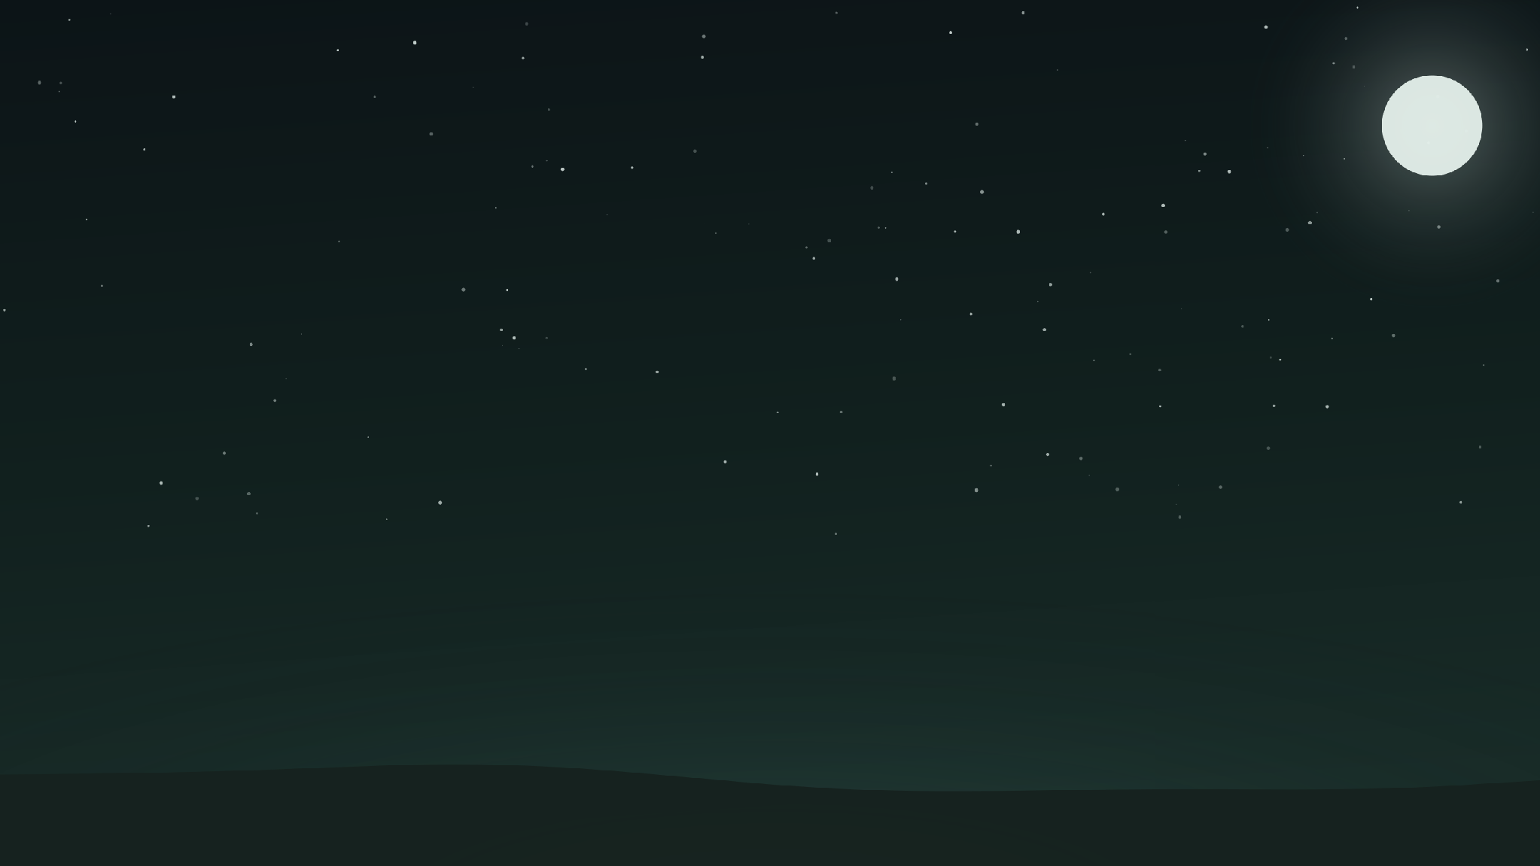
User Evaluation
a
a
a
a
a
a

Slide 8
Reflection / Next Steps
a
a
a
a
a
a

Slide 9
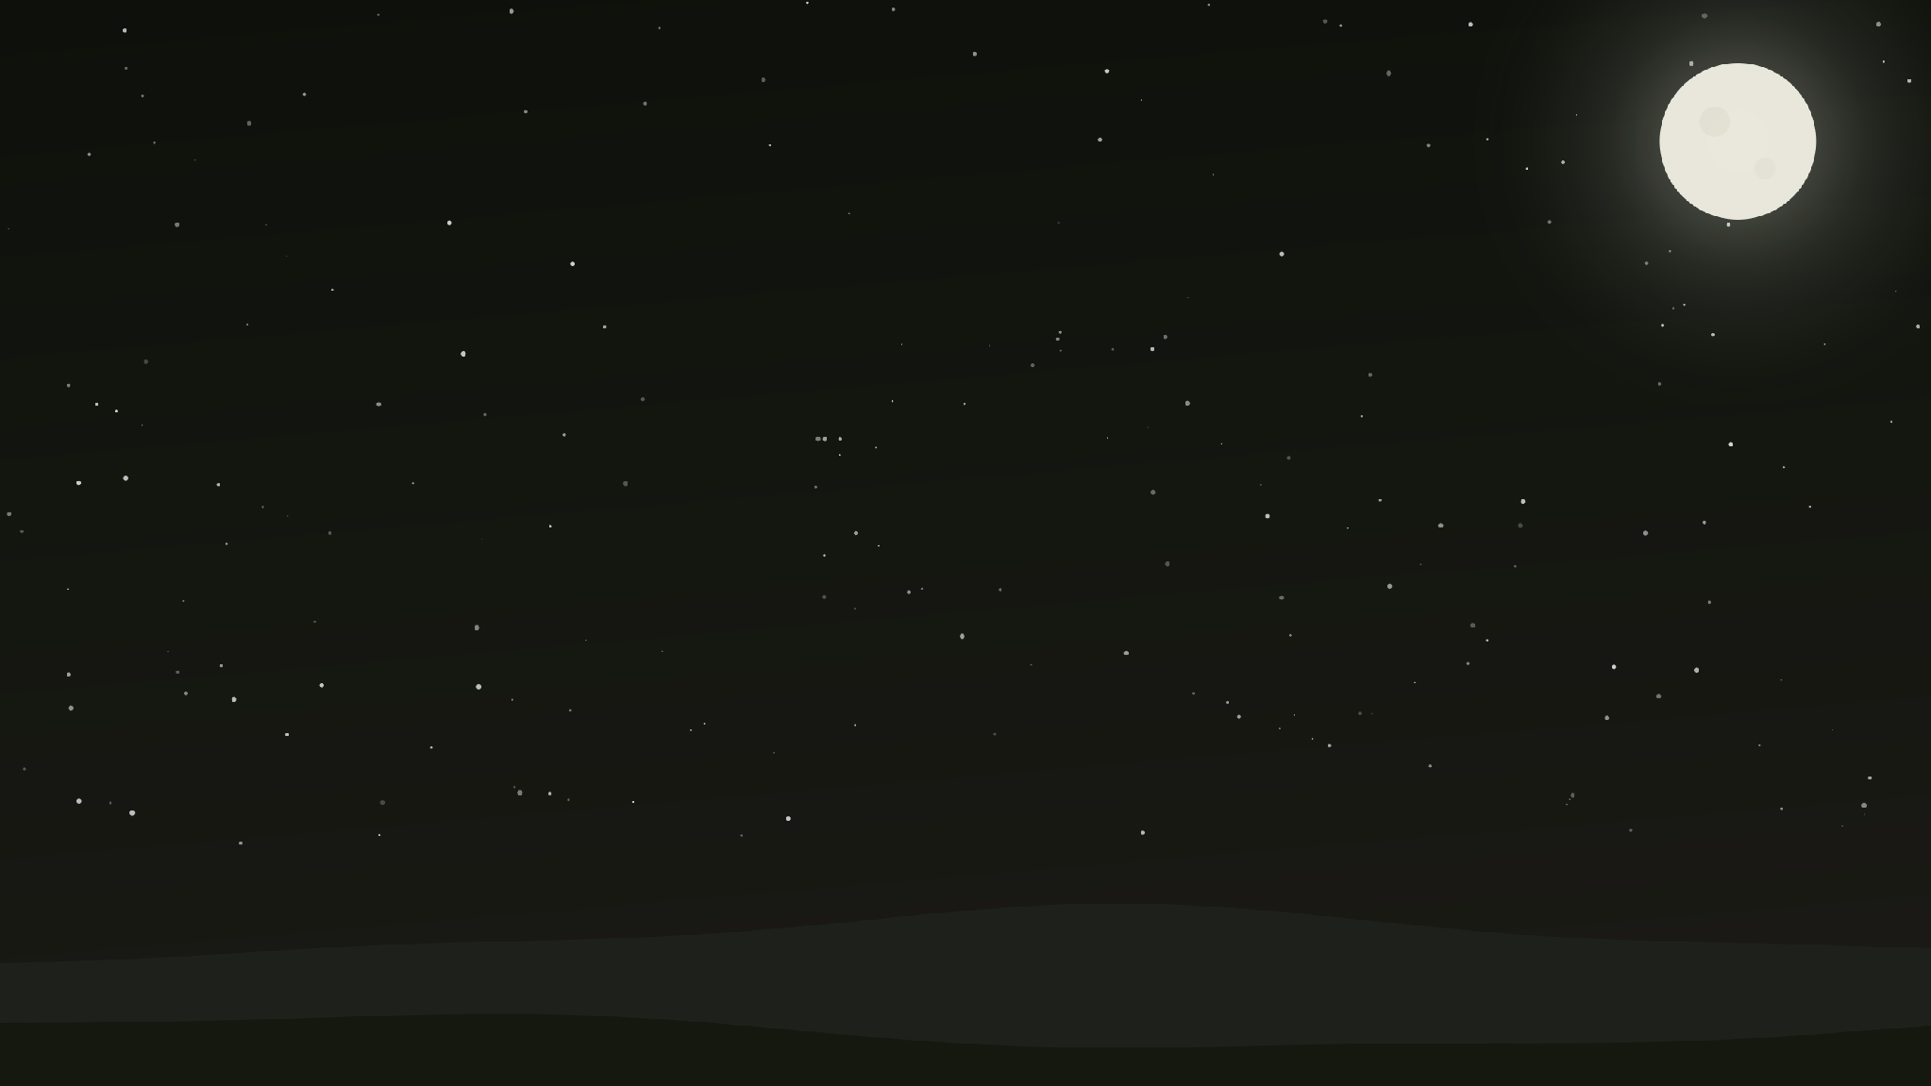
Demo Video
a
a
Notes:
turner

Slide 10
Team
a
a
a
a
a
a
Notes:
turner

Slide 11
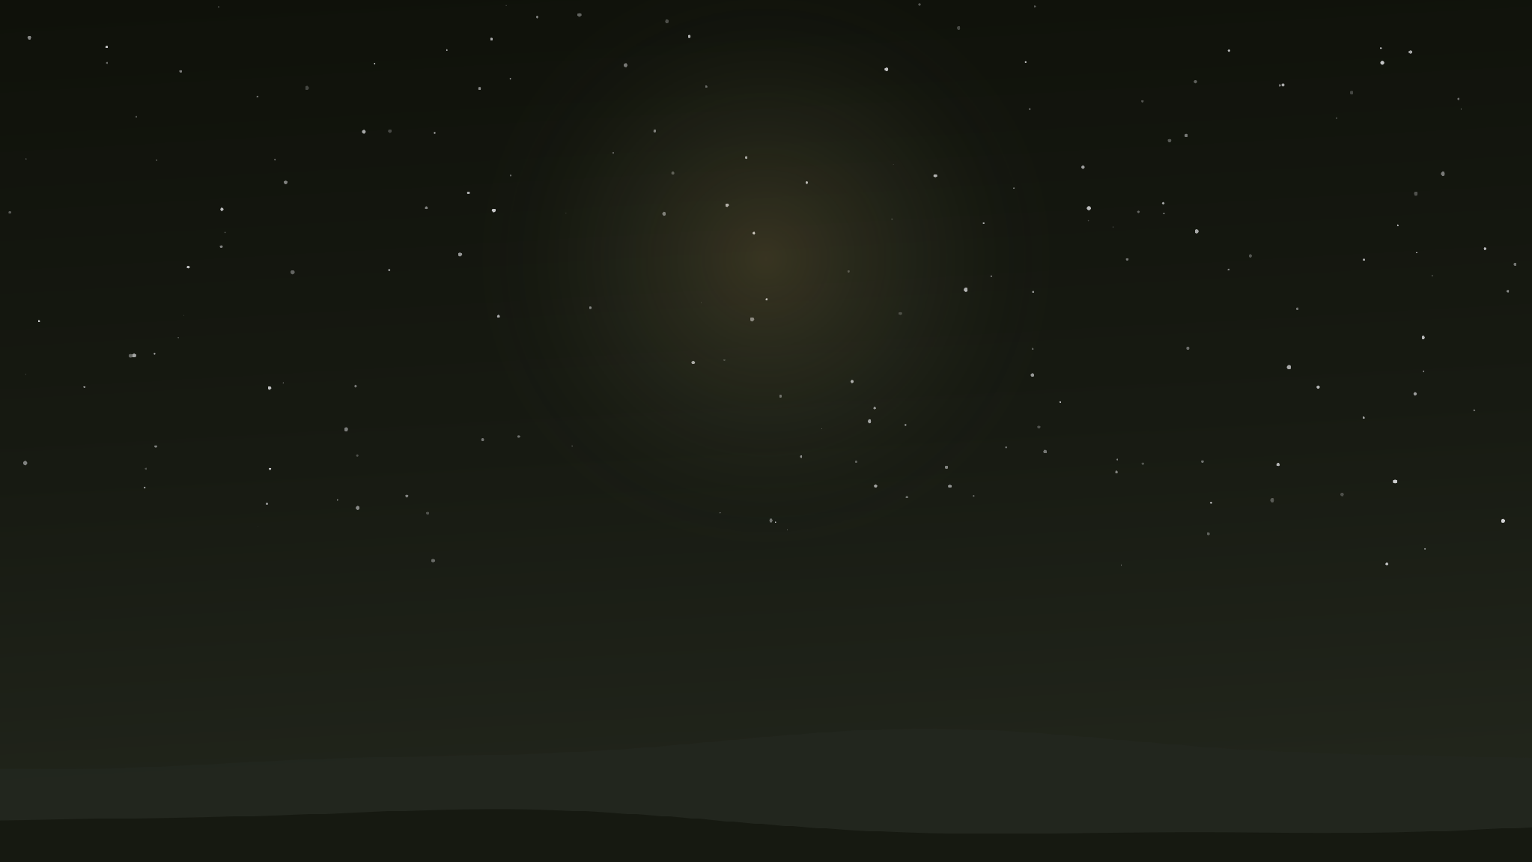
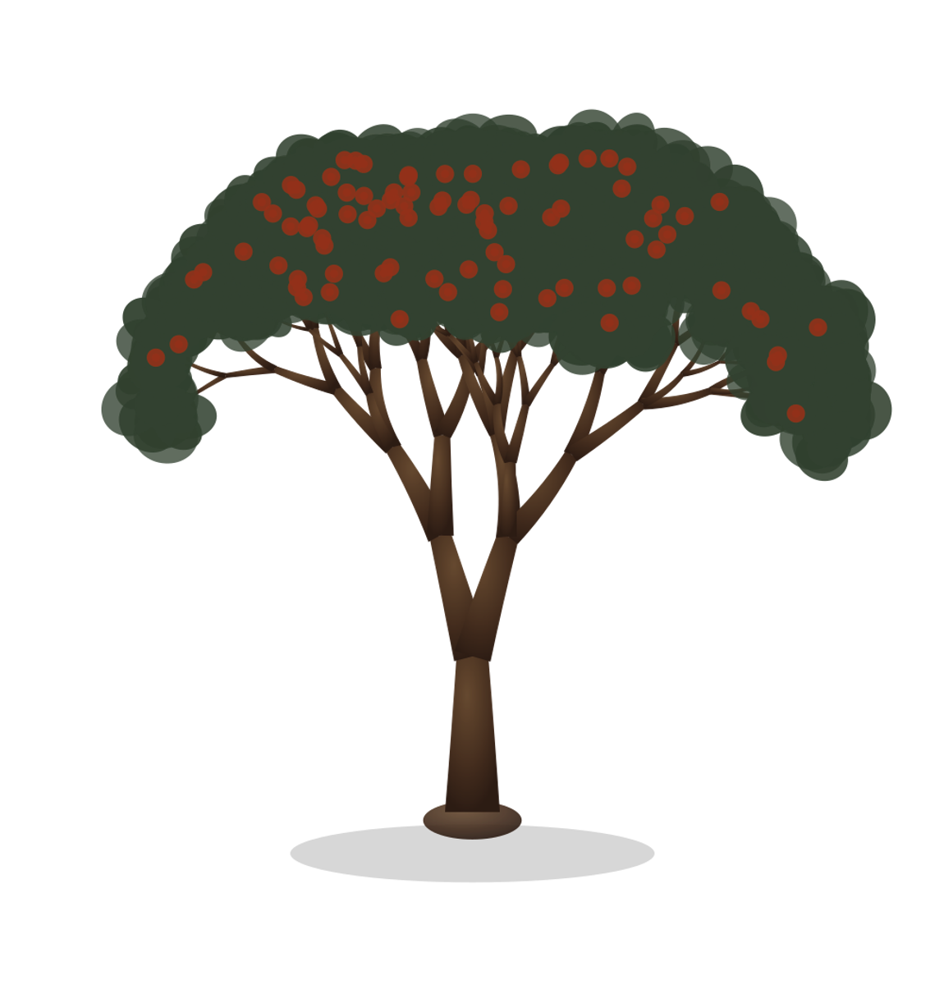
Grow together.
a

